Slide 1


Slide 2

Author
Jarosław Janiszewski:
Work in Bertelsmann Media branch Arvato Poland
Graduated Poznan University of Technology Faculty of Computer Science specialization Intelligent Decision Support Systems.
Team leader Poznan .NET Group
Preparing for a marathon

Slide 3
Agenda
New features in the integrated developer enviroment.
New features for web developers
New features for app developers

Slide 4
What's new in Visual Studio 2013 IDE
Theme , Customize IDE and New Lines
ScroolBar
BlackLine i Notification i QuickLaunch
Debugging support for 64-bit
Performance and Diagnostic
Schortcut key
References and CodeMap

Slide 5
New features for web developers
ZENCODING and CoffeScripts
Page Inspector
Browser Link

Slide 6
New features for app developers - XAML
Go To Definition
Better commenting support
IntelliSense matching
Start Tag / End Tag refactoring

Slide 7
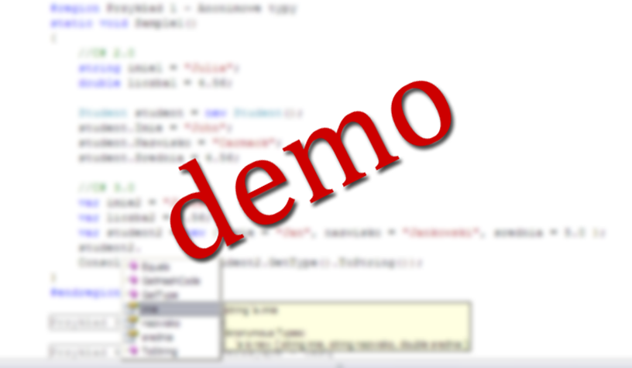

Slide 8
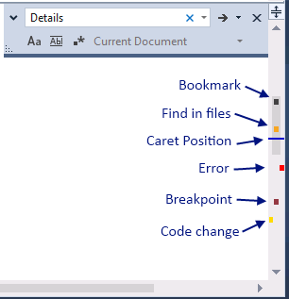
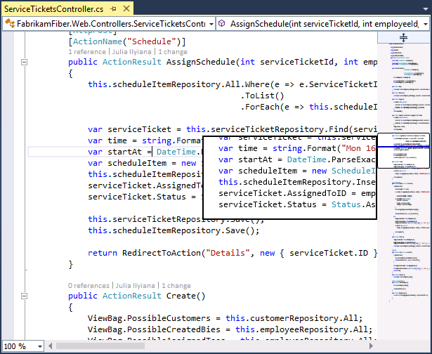
Scrollbar map mode

Slide 9

Quick Launch
Quick Launch: Basic Use
You can find Quick Launch in the upper right corner of the IDE:

Slide 10
Quick Launch shortcuts
@MRU Most recently used
@MENU searches for menu items with specified keyword
@OPT searches in Tools | Options
@DOC searches file names and paths (NOT file contents, there are other tools to help you search file contents)
@Nuget - searches in NUGET

Slide 11
Code Maps in Visual Studio 2013

Slide 12
Related Resources
Visual Studio 2013 Color schemes and editor
http://visualstudiogallery.msdn.microsoft.com/9e08e5d3-6eb4-4e73-a045-6ea2a5cbdabe
Scrollbar map mode
http://blogs.msdn.com/b/visualstudiouk/archive/2013/08/13/visual-studio-2013-enhanced-scrollbar.aspx
Quick Launch see Zain Nablowski’s blog post
http://blogs.msdn.com/b/zainnab/archive/2013/07/17/visual-studio-2013-quick-launch.aspx
Visual Studio Shortcut Keys
http://msdn.microsoft.com/en-us/library/vstudio/dn320181(v=vs.120).aspx

Slide 13
Related Resources
Code Maps in Visual Studio 2013
http://blogs.msdn.com/b/mvpawardprogram/archive/2013/11/08/code-maps-in-visual-studio-2013.aspx

Slide 14
New features for web developers

Slide 15
ZenCoding
ZenCoding code:
HTML code:
table>tr>td
<table>
<tr>
<td></td>
</tr>
</table>

Slide 16
CoffeeScript
CoffeeScript code:
"Compiled" JavaScript code:
square = (x) -> x * x
cube = (x) -> square(x) * x
var cube, square;
square = function(x) {
return x * x;
};
cube = function(x) {
return square(x) * x;
};

Slide 17
Related Resources
ZenCoding
http://codefoster.com/zencoding
CoffeScripts:
http://coffeescript.org/
New Features of ASP.NET
http://www.asp.net/visual-studio/overview/2013

Slide 18
New features for app developers

Slide 19
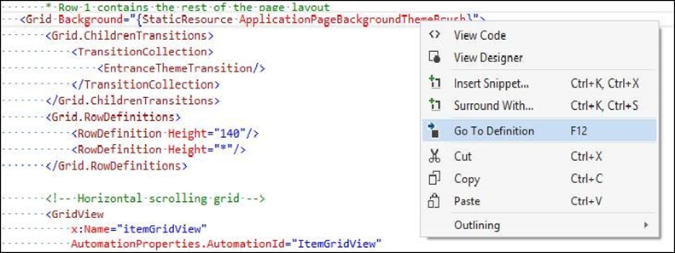
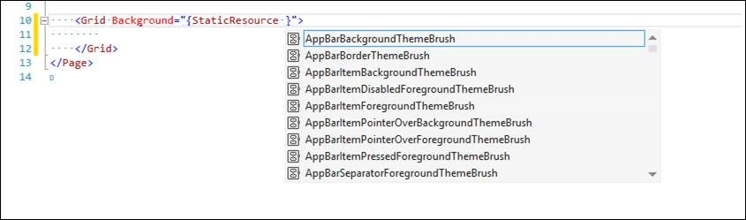
New features for app developers
Go To Definition
IntelliSense for Resources

Slide 20
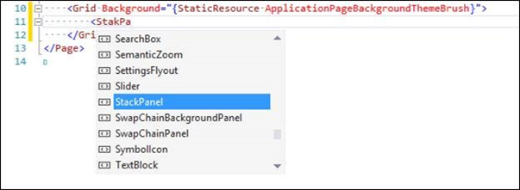
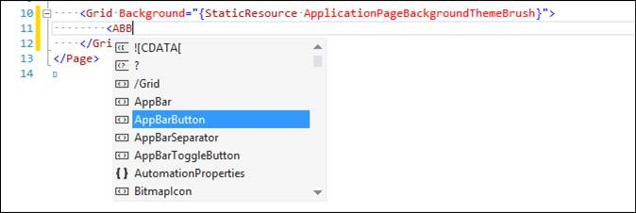
IntelliSense matching
Fuzzy matching
Notice how we select StackPanel even though you might have mistyped it as ‘StakPa”.
CamelCase matching
You don’t need to type long Type names anymore. Its abbreviation will work just fine, e.g typing “ABB” will select AppBarButton.

Slide 21
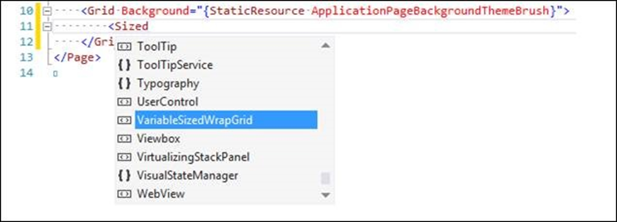
IntelliSense matching c.d.
Substring matching
For example, typing “Sized” will select VariableSizedWrapGrid.
Start Tag / End Tag refactoring
This feature automatically updates the start or end tag of a XAML element while you are editing its corresponding start or end tag. Moreover adding the ‘/’ character to a start tag will remove the corresponding end tag without affecting the element’s inner content.

Slide 22
Related Resources
XAML Editor Improvements in Visual Studio 2013
http://blogs.msdn.com/b/visualstudio/archive/2013/08/09/xaml-editor-improvements-in-visual-studio-2013.aspx

Slide 23
Where can I get Visual Studio 2013?
MSDN subscribers can download
Startup companies may qualify for MSDN through BizSpark
www.Microsoft.com/bizspark
Students can access through Dreamspark
www.dreamspark.com
Anyone can download Express or Trial versions at http://www.visualstudio.com/downloads
Visual Studio Online – free for up to 5 users www.visualstudio.com/vsonline

